Slide 1





Most subscribed Youtube channels Report
p
.

Slide 2
name = anshul kumar roll no = 237042 branch = ai & ml
.

Slide 3
Introduction
1. Excel sheet
2 . My SQL data
3 . Pycharm Graphs
4 . Power Bi Dashboard

Slide 4
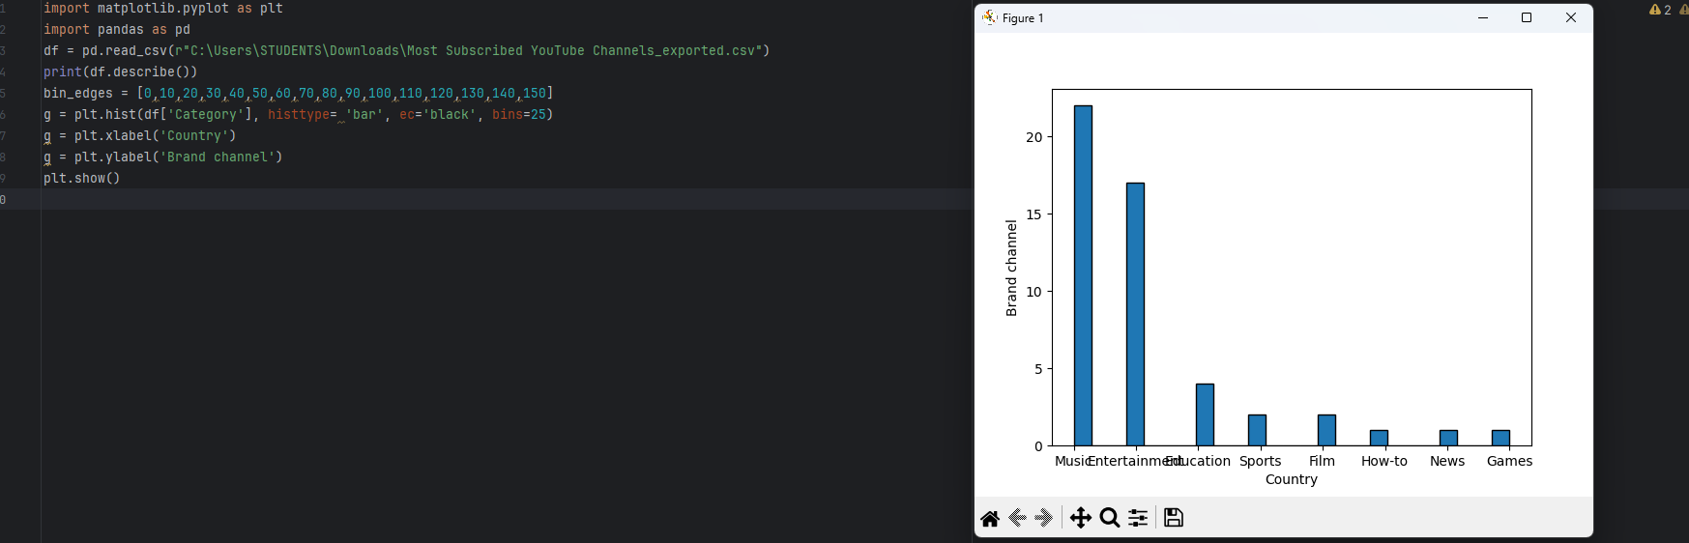
GRAPH : 1

Slide 5

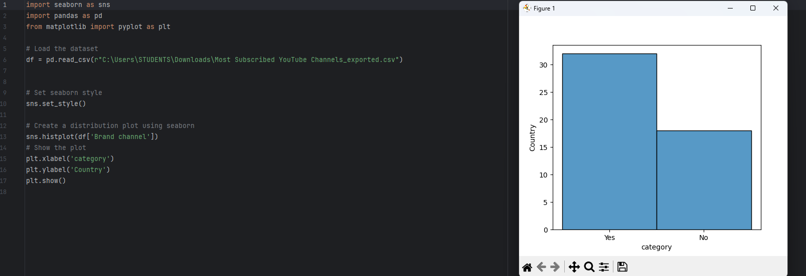

h
GRAPH : 2

Slide 6
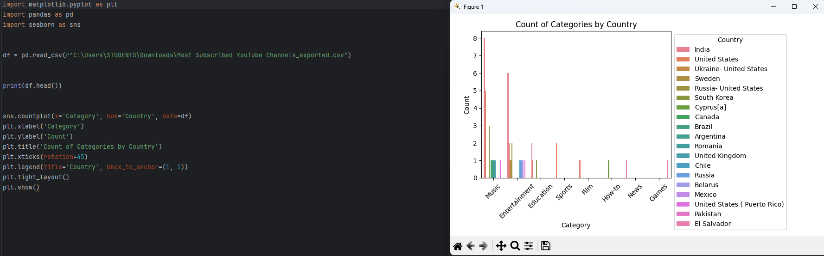
GRAPH : 3

Slide 7
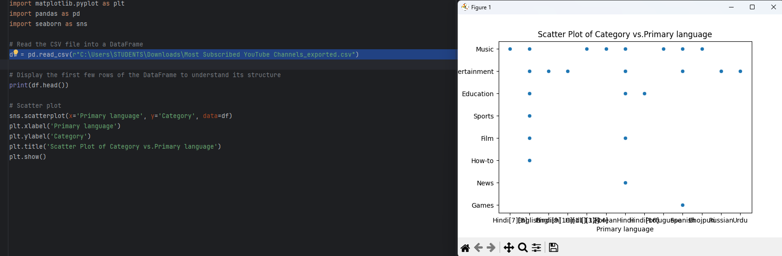

.
GRAPH : 4

Slide 8
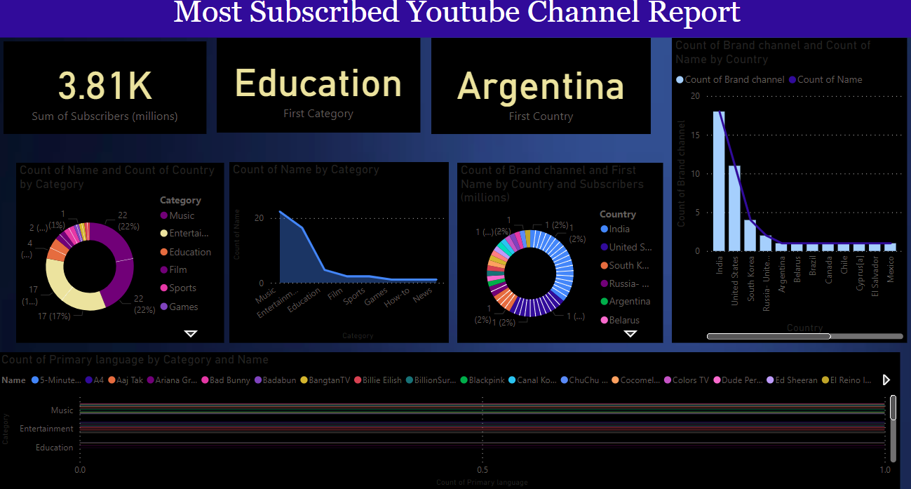
power bi Dashboard

Slide 9
Thank you
.

